Slide 1


FLIGHT PASSENGER SATISFACTION

Slide 2
Content
Introduction
Flowchart of Project Methodology
Problem Statement
Data Acquisition & Processing
Data Visualization
Feature Selection
Model Building & Predictions:
Model Deployment
Comparison of Algorithms
Code
Conclusion

Slide 3
Introduction
This Dataset contains US airline passenger satisfaction survey.
We will guess whether the passengers are satisfied with the trip.
We will try to use this data to create a model which tries to predict the passenger satisfaction.
We will use various machine learning algorithms in our model.

Slide 4
Flowchart of Project Methodology
1. Understanding Problem Statement
2. Data Mining
3. Data Cleaning
4. Exploratory Data Analysis
8. Predictions
7. Model Building
6. Sampling
(Train & Test Data)
5. Feature Selection
9. Results based on the Data

Slide 5
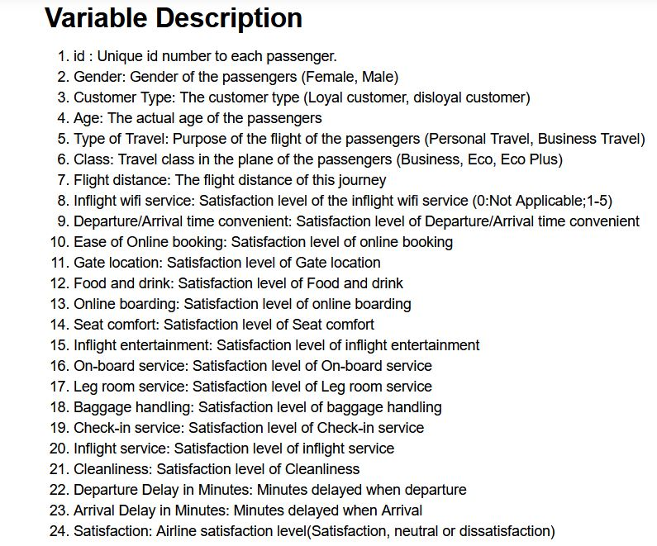
Problem Statement
What factors are highly correlated to a satisfied(or dissatisfied) passenger? Can we predict passenger Satisfaction?
Our problem data and derive conclusions are on the passenger satisfaction with the trip using different models in Python

Slide 6
Data Acquisition & Processing
Data source:
Kaggle -https://www.kaggle.com/airline-passenger-satisfaction
Data Processing
Identified the columns with NA/NaN values.The missing values in the data were all focused in the Arrival Delay in Minutes column.
We have dropped the unnamed:0 and id column, as id is unique for each passenger.
Analyzed the data-types using dtypes function and performed variable transformation.

Slide 7
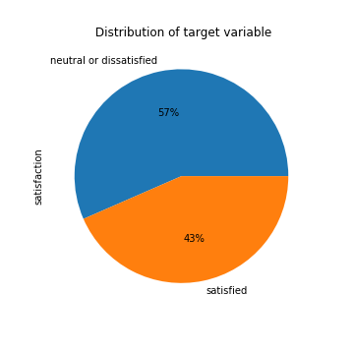
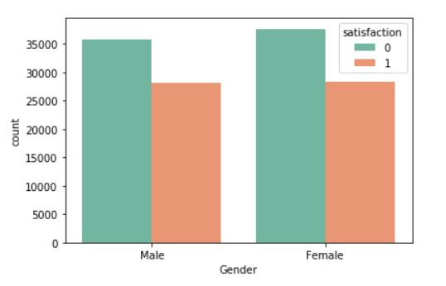
Data Visualization
After cleaning of the data, we try to get insights by using visualization techniques

Slide 8
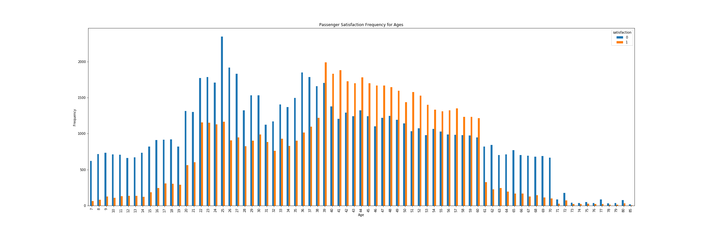
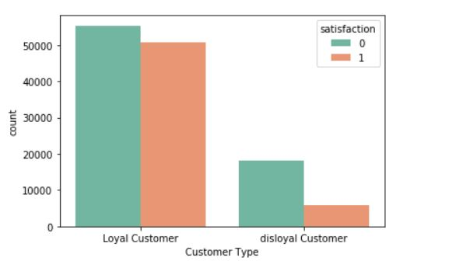
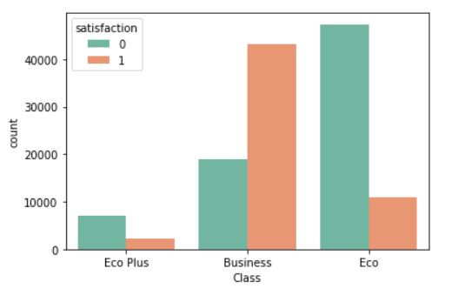
Data Visualization

Slide 9
Feature Selection
Lastly, for feature selection, we have used various feature selection techniques to understand the significant attributes from the data.
We have used Decision Tree and Recursive Feature Elimination method to choose the most important attributes of the data.

Slide 10
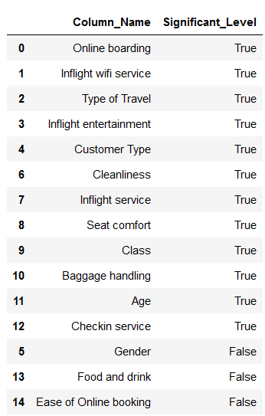
1. Recursive Feature Elimination Method

Slide 11
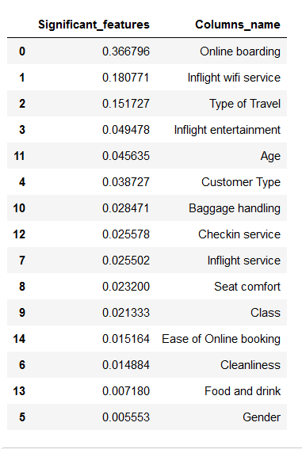
2. Decision Tree

Slide 12
Model Building & Predictions:
We have implemented various machine learning algorithms such as Logistic Regression, Decision Tree and Adaptive Boosting in order to identify the most optimal model.
For each of these models the Confusion Matrix, Accuracy, Sensitivity, Specificity and false positive rate were calculated.
Further we found importance and results based on the models we have used.

Slide 13
Model Deployment
Logistic Regression Model
Decision Tree
Adaptive Boosting
Voting Classifier

Slide 14
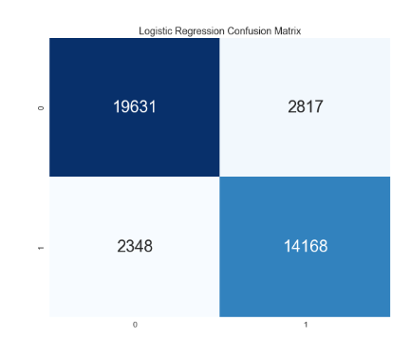
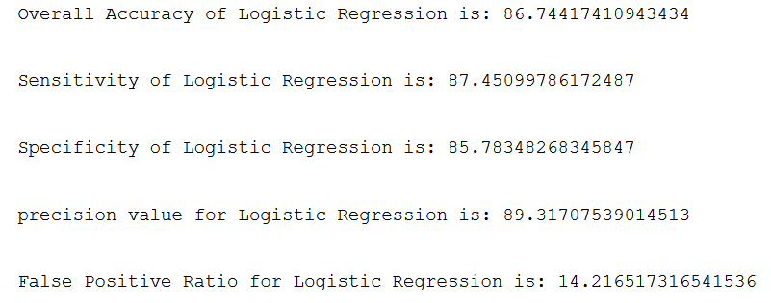
Result Interpretation – Logistic Regression
The matrix represents 19631 true positive values which means that all of these records were correctly predicted as leading to a Confirmation.
14168 are true negative values which means that all of these records were correctly predicted as not leading to a Confirmation.
2817 are false positive values which means that all of these records were predicted as leading to a Confirmation but did not actually result in a Confirmation.
2348 are false negative values which means that all of these records were predicted as not leading to a Confirmation but actually result in a Confirmation.
Accuracy: The accuracy 86.74 % is used as an appropriate representation of the model.
Precision: The score 0.8931 implies that if a model predicts a class for the record as confirmed there is an 89.31% likelihood that the model is correct.
Recall: The score 0.8745 implies that the model can recall 87.45 % of instances of a particular class.

Slide 15
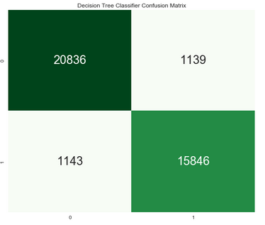
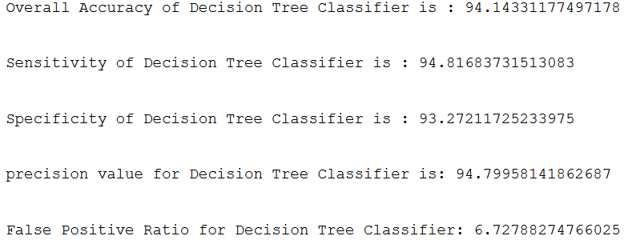
Result Interpretation – Decision Tree
Confusion Matrix: The matrix represents 20832 true positive values which means that all of these records were correctly predicted as leading to a Confirmation.
15874 are true negative values which means that all of these records were correctly predicted as not leading to a Confirmation.
1138 are false positive values which means that all of these records were predicted as leading to a Confirmation but did not actually result in a Confirmation.
1147 are false negative values which means that all of these records were predicted as not leading to a Confirmation but actually result in a Confirmation.
Accuracy: The accuracy 94.13% is used as an appropriate representation of the model.
Precision: The score 0.9478 implies that if a model predicts a class for the record as confirmed there is an 94.78% likelihood that the model is correct.
Recall: The score 0.9482 implies that the model can recall 94.82% of instances of a particular class.

Slide 16
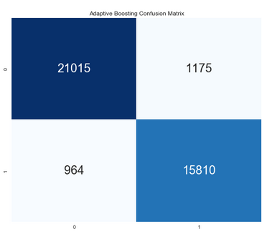
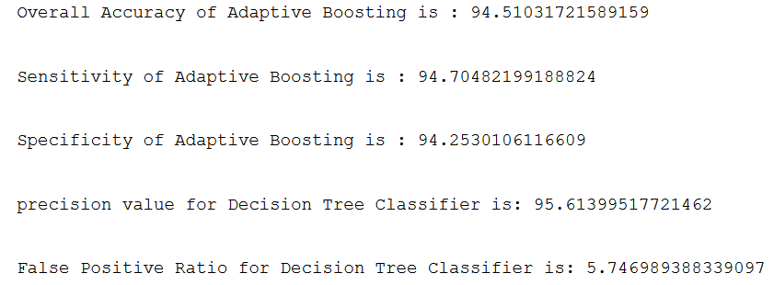
Result Interpretation – Adaptive Boosting
Confusion Matrix: The matrix represents 21040 true positive values which means that all of these records were correctly predicted as leading to a Confirmation.
15803 are true negative values which means that all of these records were correctly predicted as not leading to a Confirmation.
1182 are false positive values which means that all of these records were predicted as leading to a Confirmation but did not actually result in a Confirmation.
939 are false negative values which means that all of these records were predicted as not leading to a Confirmation but actually result in a Confirmation.
Accuracy: The accuracy 94.55 % is used as an appropriate representation of the model.
Precision: The score 0.9572implies that if a model predicts a class for the record as confirmed there is an 95.72% likelihood that the model is correct.
Recall: The score 0.9467 implies that the model can recall 94.68% of instances of a particular class.

Slide 17
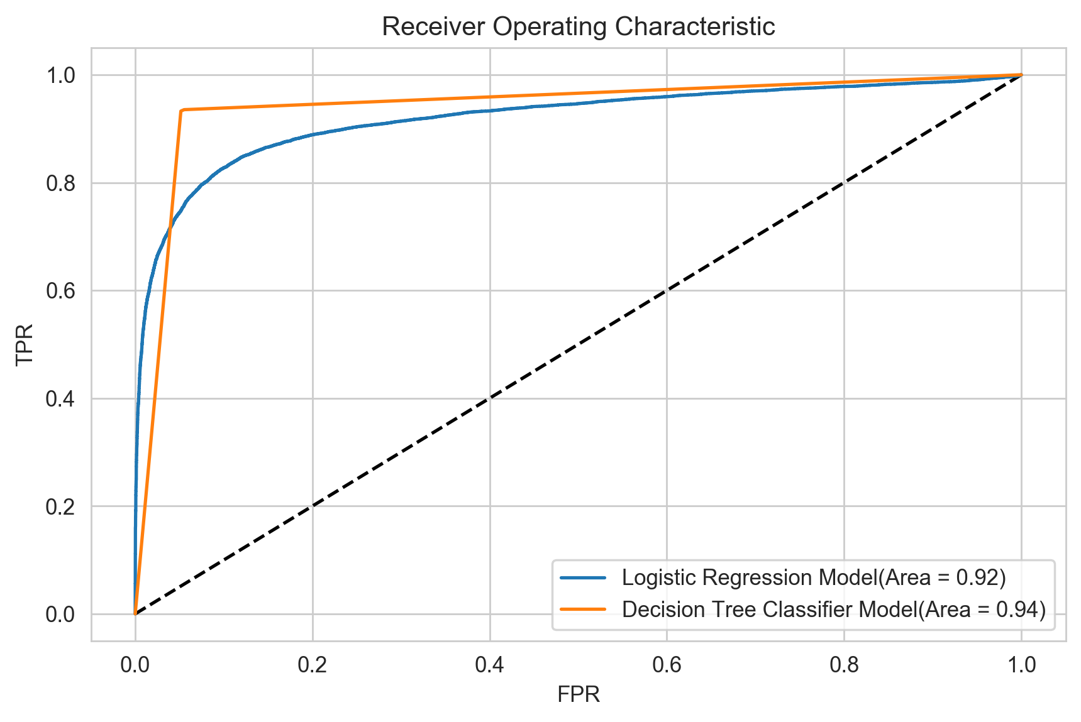
ROC Curve Interpretation
Area Under ROC Curve:
Logistic Regression – 0.92
Decision Tree – 0.94
Logistic Regression -Blue
Decision Tree - Yellow

Slide 18
Comparison of Algorithms

Slide 19
Model Result Matrix
Sr No | Model | Accuracy | Sensitivity | Specificity | Precision | False Positive Ratio
1. | Logistic Regression | 78.07% | 87.45% | 85.78% | 89.31% | 14.21%
2. | Decision Tree | 94.13% | 94.82% | 93.24% | 94.77% | 6.75%
3. | Adaptive Boosting | 94.31% | 94.38% | 94.22% | 95.60% | 5.77%

Slide 20
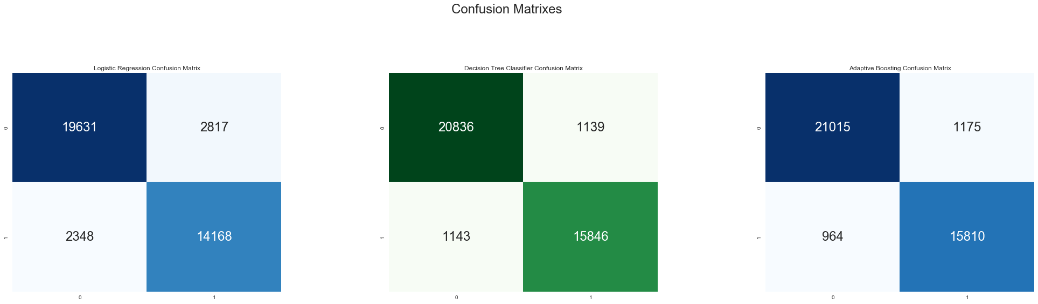
Confusion Matrixes

Slide 21
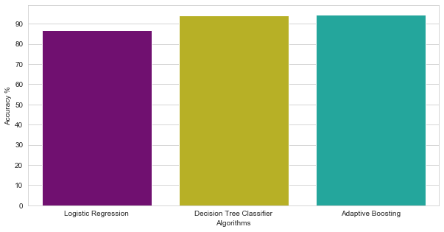
Comparison of Algorithms

Slide 22
Code

Slide 23
Conclusion
Comparing the accuracy of the different models, Decision Tree is the best among the classification models.
Recursive Feature Elimination Method highlights the importance of predictors Online boarding, Inflight wifi service, Type of Travel, Inflight Entertainment, Age, Gender , Customer Type.
After analyzing all the models we can conclude that predictors Online boarding, Inflight wifi service, Type of Travel did played a major role for Flight Passenger Satisfaction
We can conclude that with the help of voting classifier Our model estimates 95.39% correctly. Our model works well.

